Slide 1

Travel AI Agent
IBM AICTE PROJECTPresented By: Kavvya MCollege Name & Department: MIT ACADEMY OF ENGINEERING, COMPUTER ( SOFTWARE ) ENGINEERING DEPARTMENT

Slide 2
Slide 2: Outline
Problem Statement
Technology Used
Wow Factor
End Users
Results
Conclusion
GitHub Link
Future Scope
IBM Certifications

Slide 3
Slide 3: Problem Statement
Challenge: Travel planning can be overwhelming, time-consuming, and confusing, especially when considering multiple variables like budget, time, weather, transport, and accommodation.
Proposed Solution: An AI-powered Travel Planner Agent that:
Understands user preferences and budget
Suggests destinations
Builds personalized itineraries
Recommends transportation and stays
Provides real-time weather and map info
Manages bookings and alerts
Optimizes travel schedules for a seamless experience

Slide 4
Slide 4: Technology Used
IBM Cloud Lite Services
IBM Granite Foundation Model
Natural Language Processing (NLP)
Generative AI for conversational queries
Integration with Maps, Weather APIs, and Booking Systems

Slide 5
Slide 5: IBM Cloud Services Used
IBM Cloud Watsonx.ai Studio
IBM Cloud Watsonx.ai Runtime
IBM Cloud Agent Lab
IBM Granite Foundation Model

Slide 6
Slide 6: Wow Factor
Conversational AI
Personalized Itineraries
Live Integration
Provides travel recommendations in real-time
Based on budget, interests, and dates
With maps, weather, and local guides
Alerts
Optimized Travel Plans
Scalable and Easy to Deploy
For flight changes, traffic conditions, and accommodation availability
To save time and reduce cost
Using IBM Granite & Watsonx

Slide 7
Slide 7: End Users
Frequent Travelers
Tourism Boards
Corporate Travel Planners
Students planning study tours
Travel Agencies
Casual tourists seeking smart trip planning

Slide 8

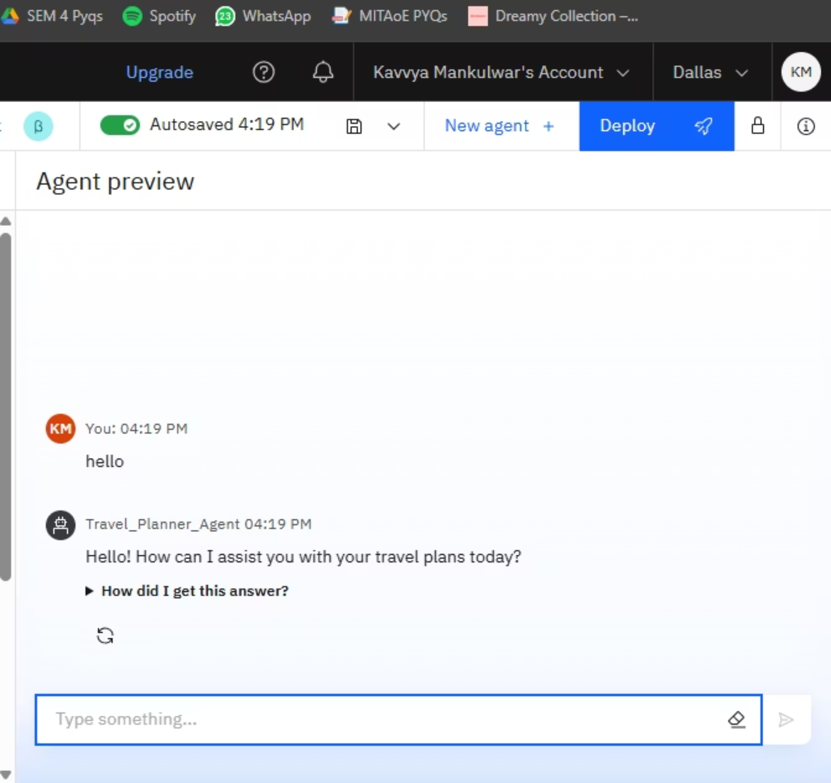
Slide 8 Results

Slide 9
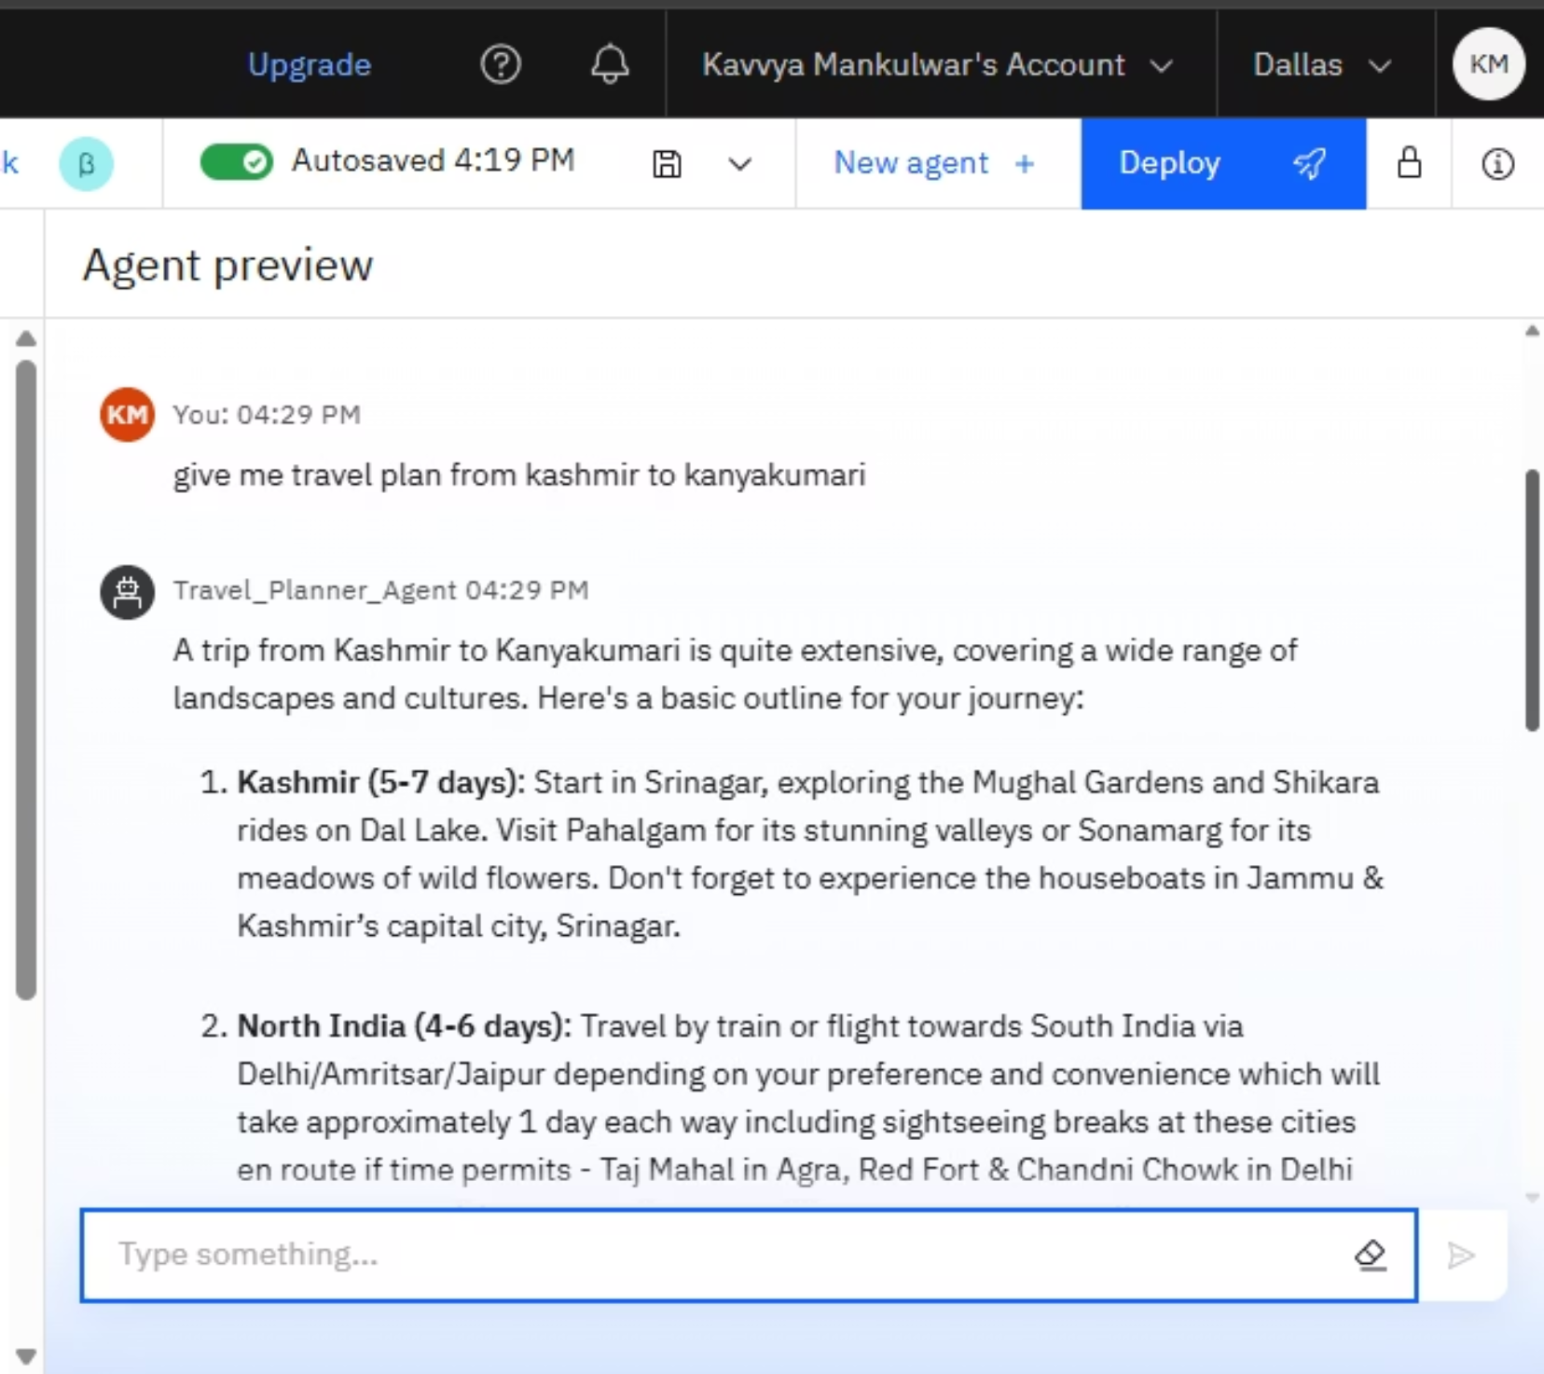
Slide 9 Results
Answered user queries on destinations, transport options, and budgets

Slide 10
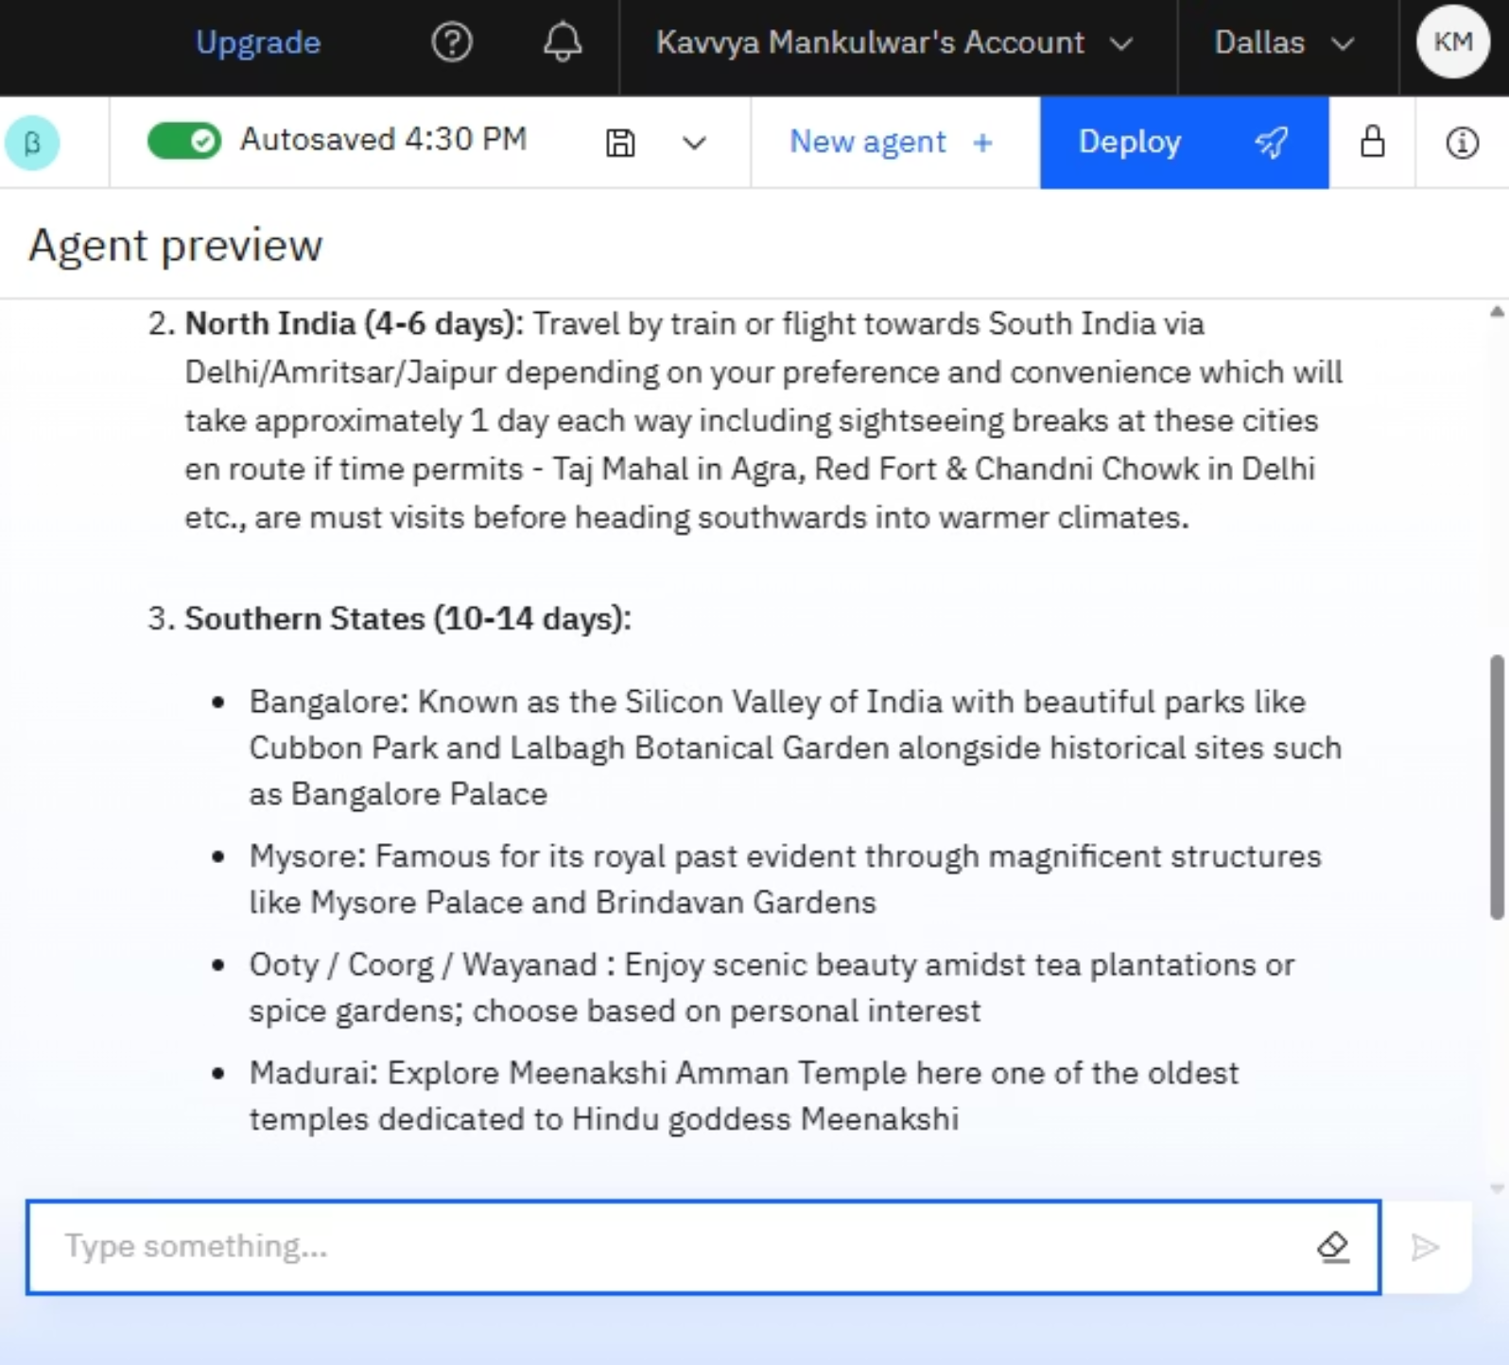
Slide 10 Results
Provided end-to-end itinerary suggestions with high accuracy

Slide 11
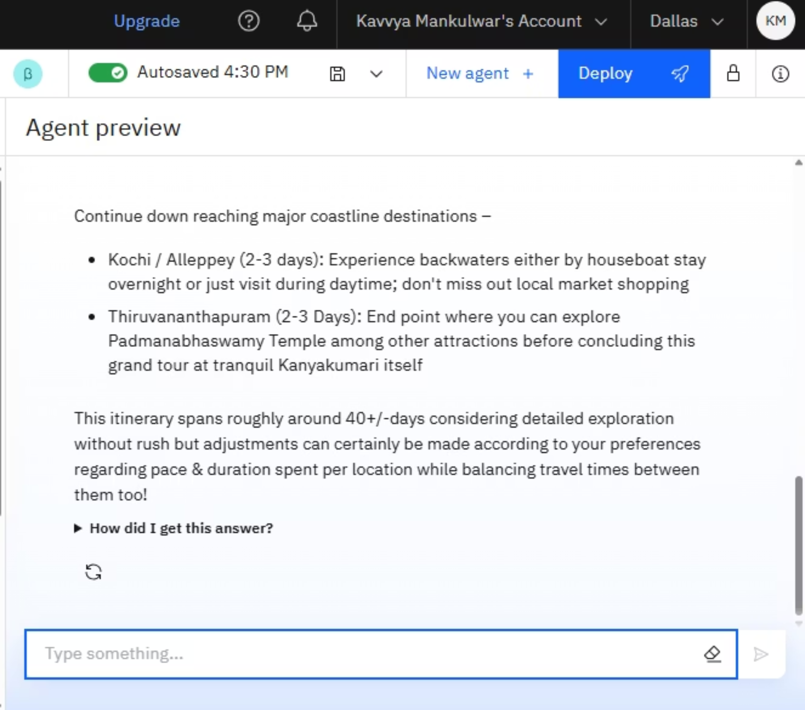
Slide 11 Results

Slide 12
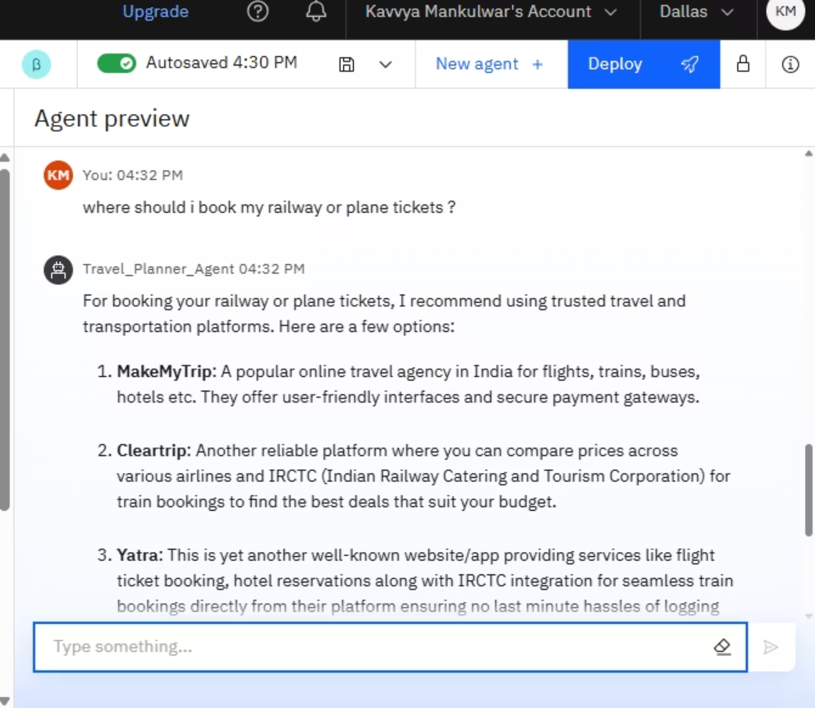
Slide 12 Results

Slide 13
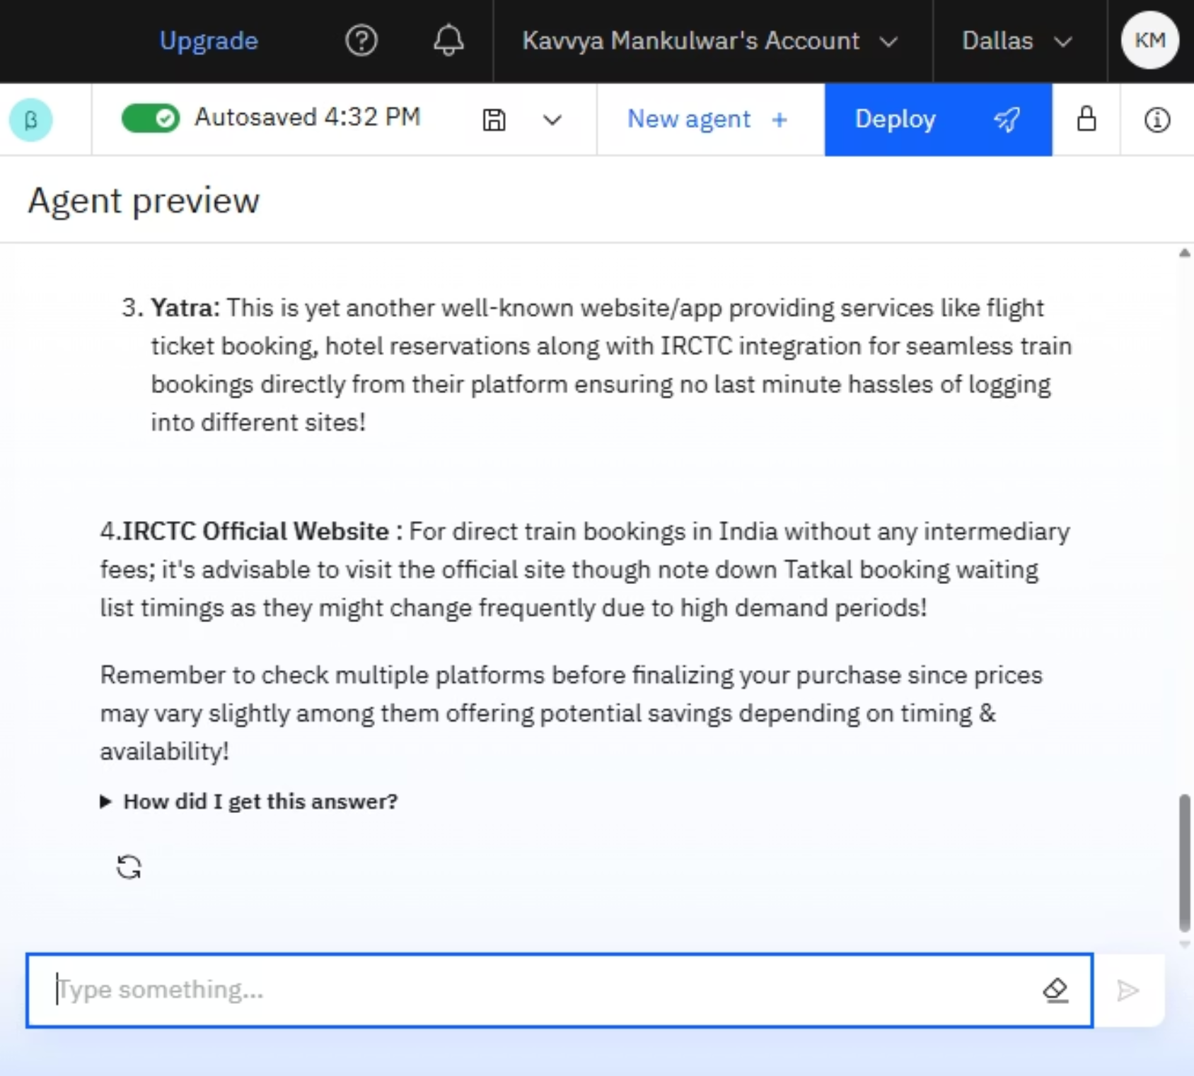
Slide 13 Results

Slide 14
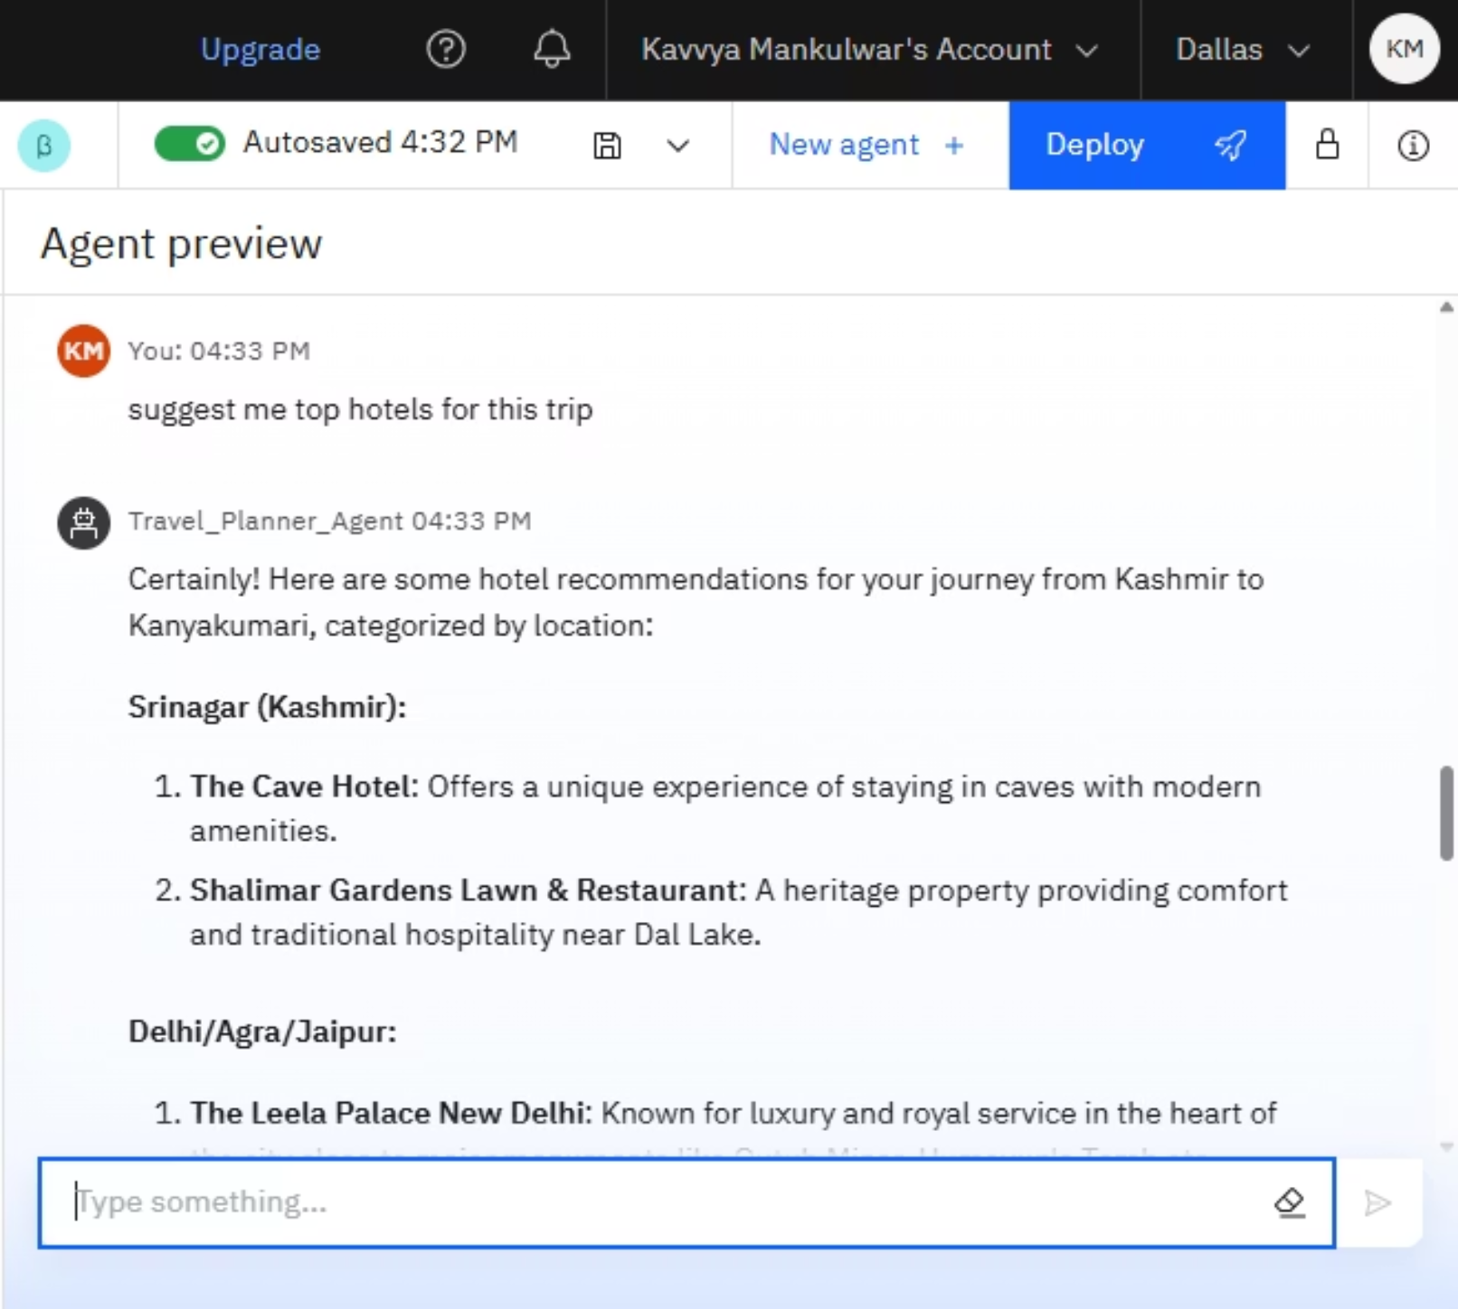
Slide 14 Results

Slide 15
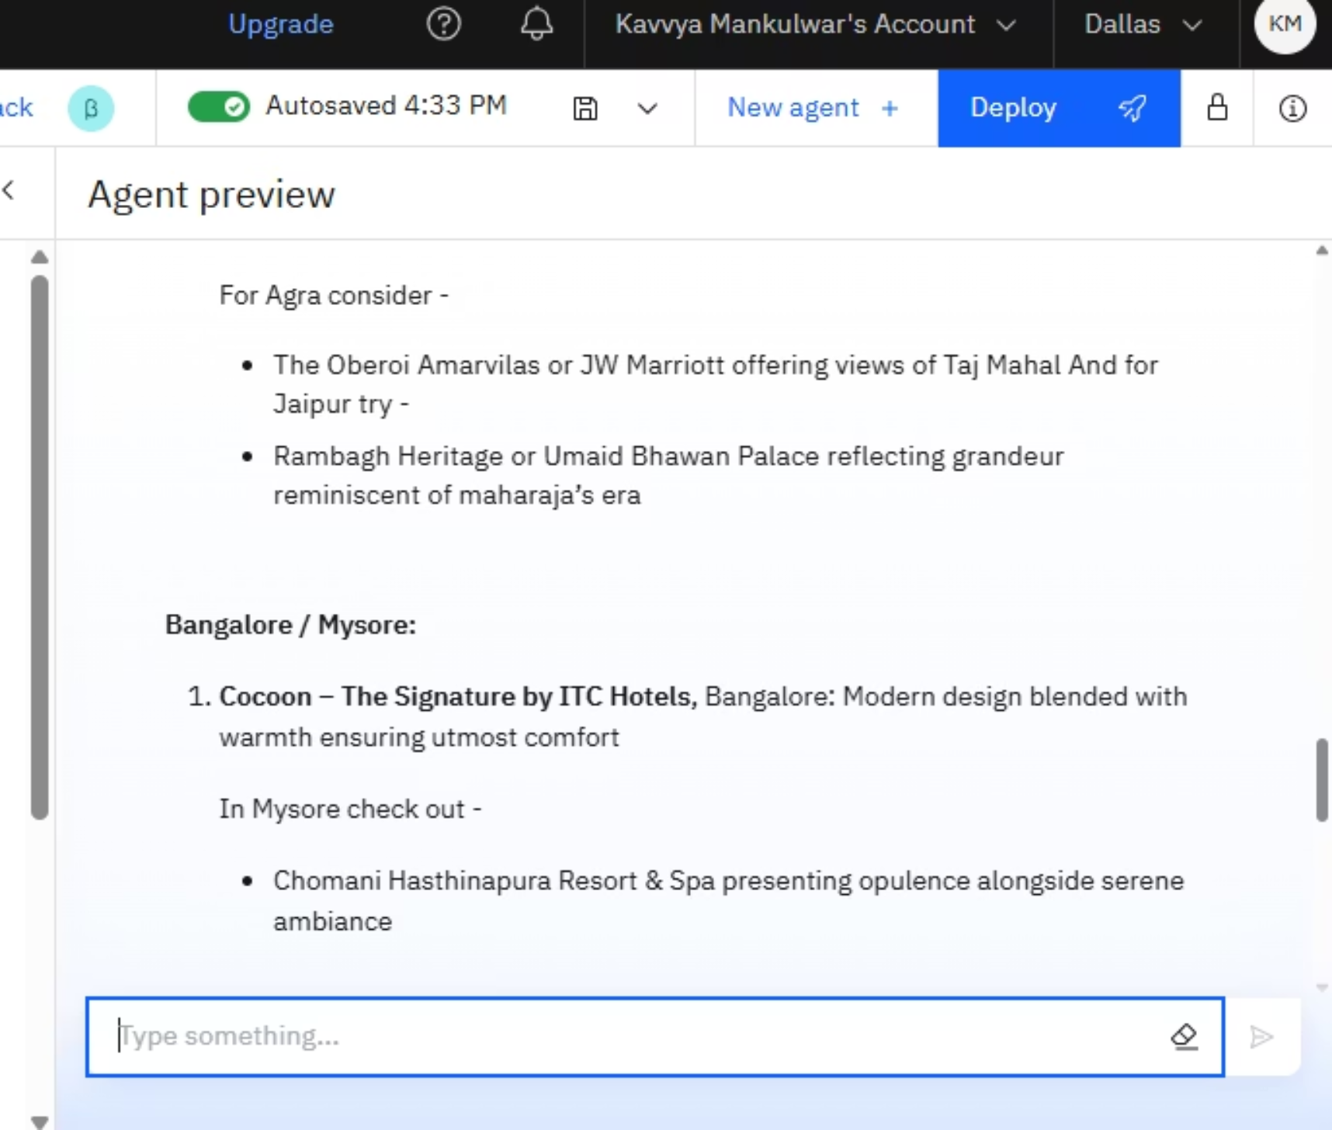
Slide 15 Results

Slide 16
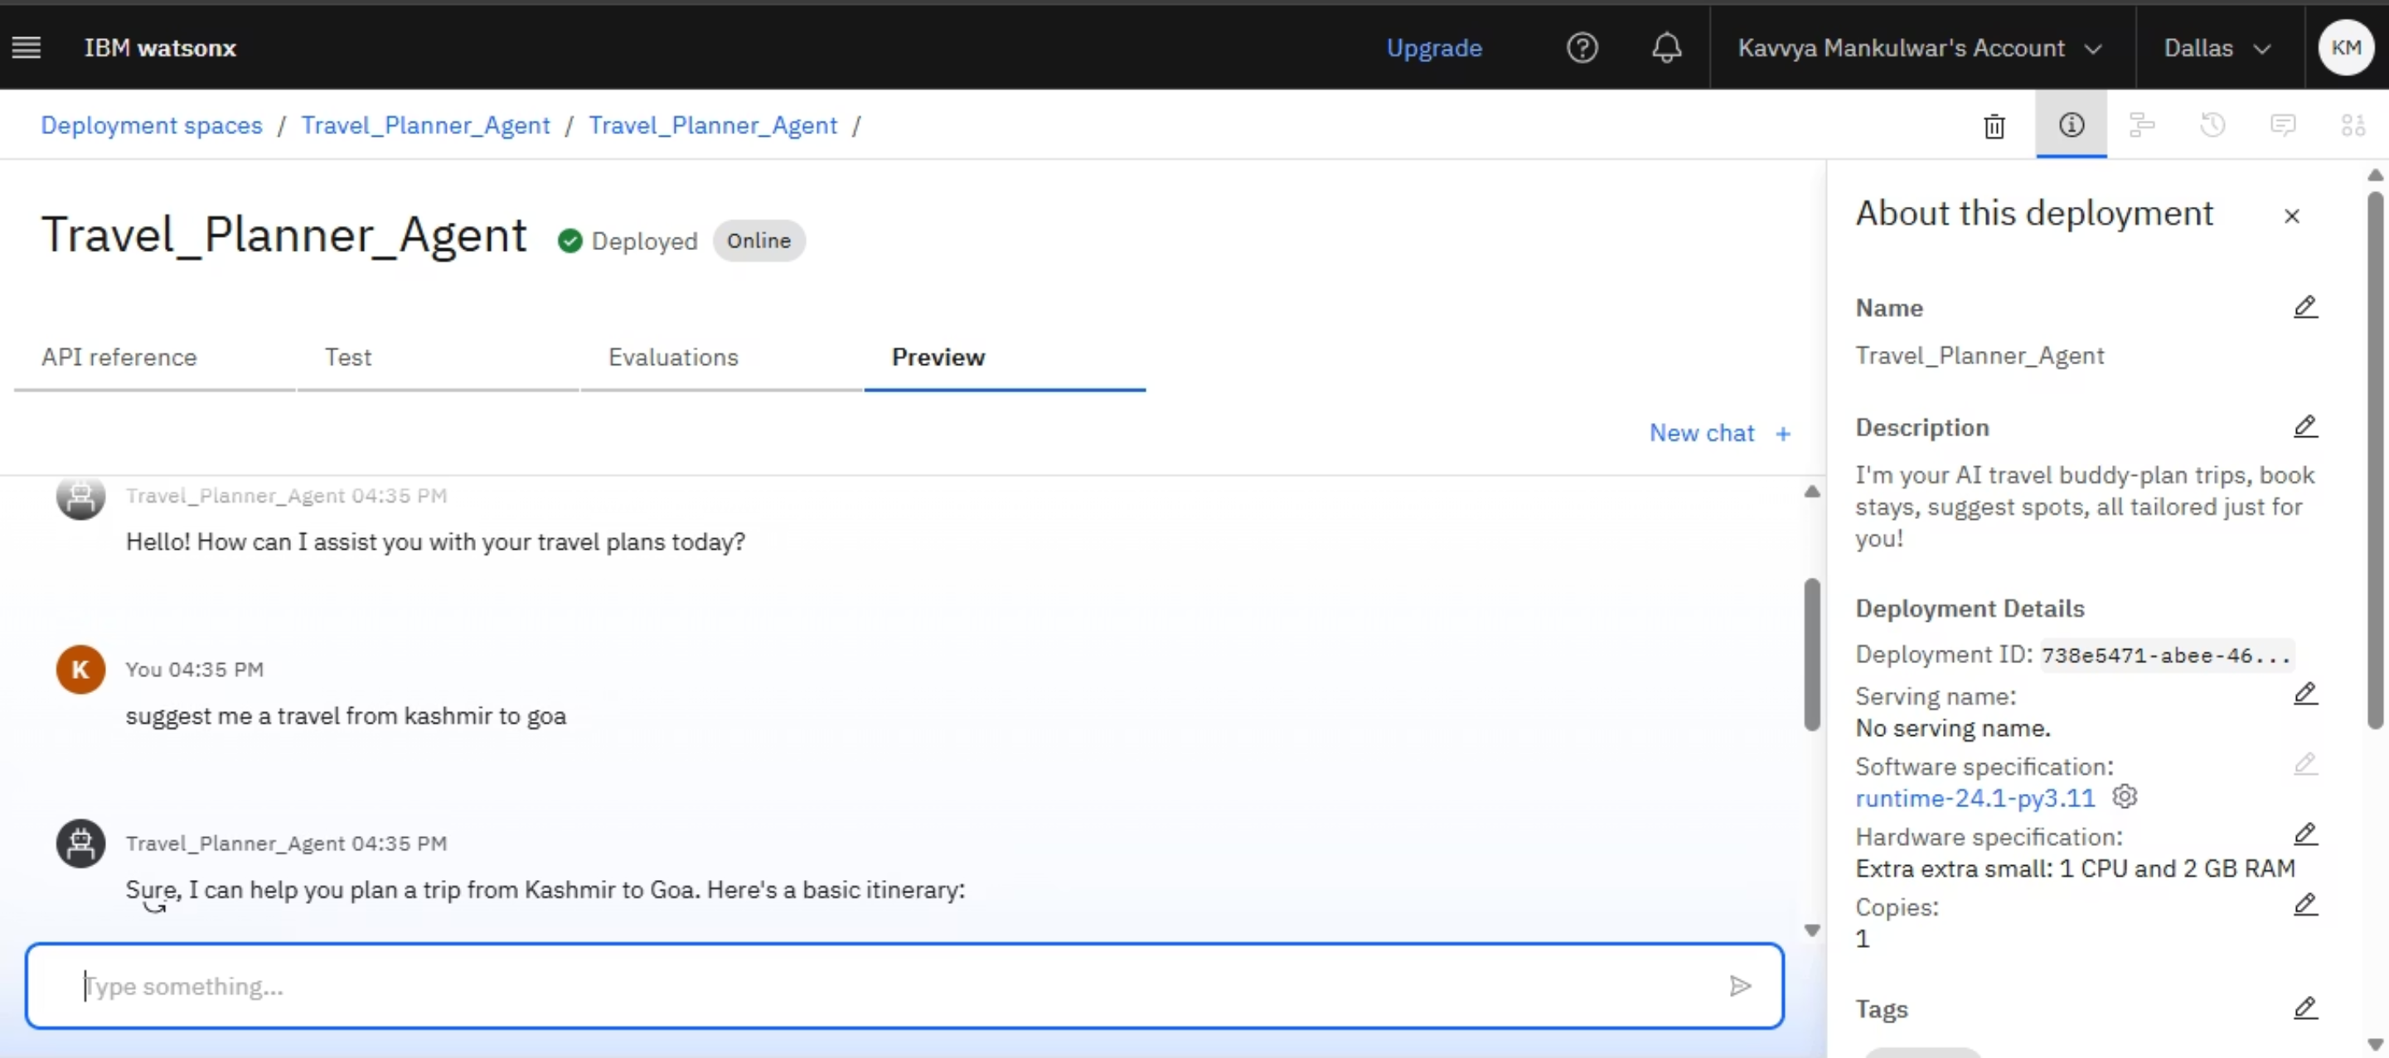
Slide 16 Results
AI Travel Agent successfully deployed on IBM Cloud

Slide 17
Slide 17 Conclusion
Simplifies Travel
Intelligent & Personalized
The Travel Planner Agent simplifies the entire travel process
Makes planning more intelligent, personalized, and stress-free
Saves Time & Informs
Powerful AI Use
Helps users save time, avoid confusion, and stay informed
Demonstrates powerful use of AI + IBM Granite + NLP for real-world applications

Slide 18
Slide 18: GitHub Link
https://github.com/Kavvya-2122/Travel_Planner_Agent

Slide 19
Slide 19: Future Scope
Multi-language support for international travelers
Voice-based agent for on-the-go conversations
Real-time currency conversion and visa requirement checks
AI-powered local guide recommendations and safety alerts
Integration with booking APIs for direct reservations

Slide 20
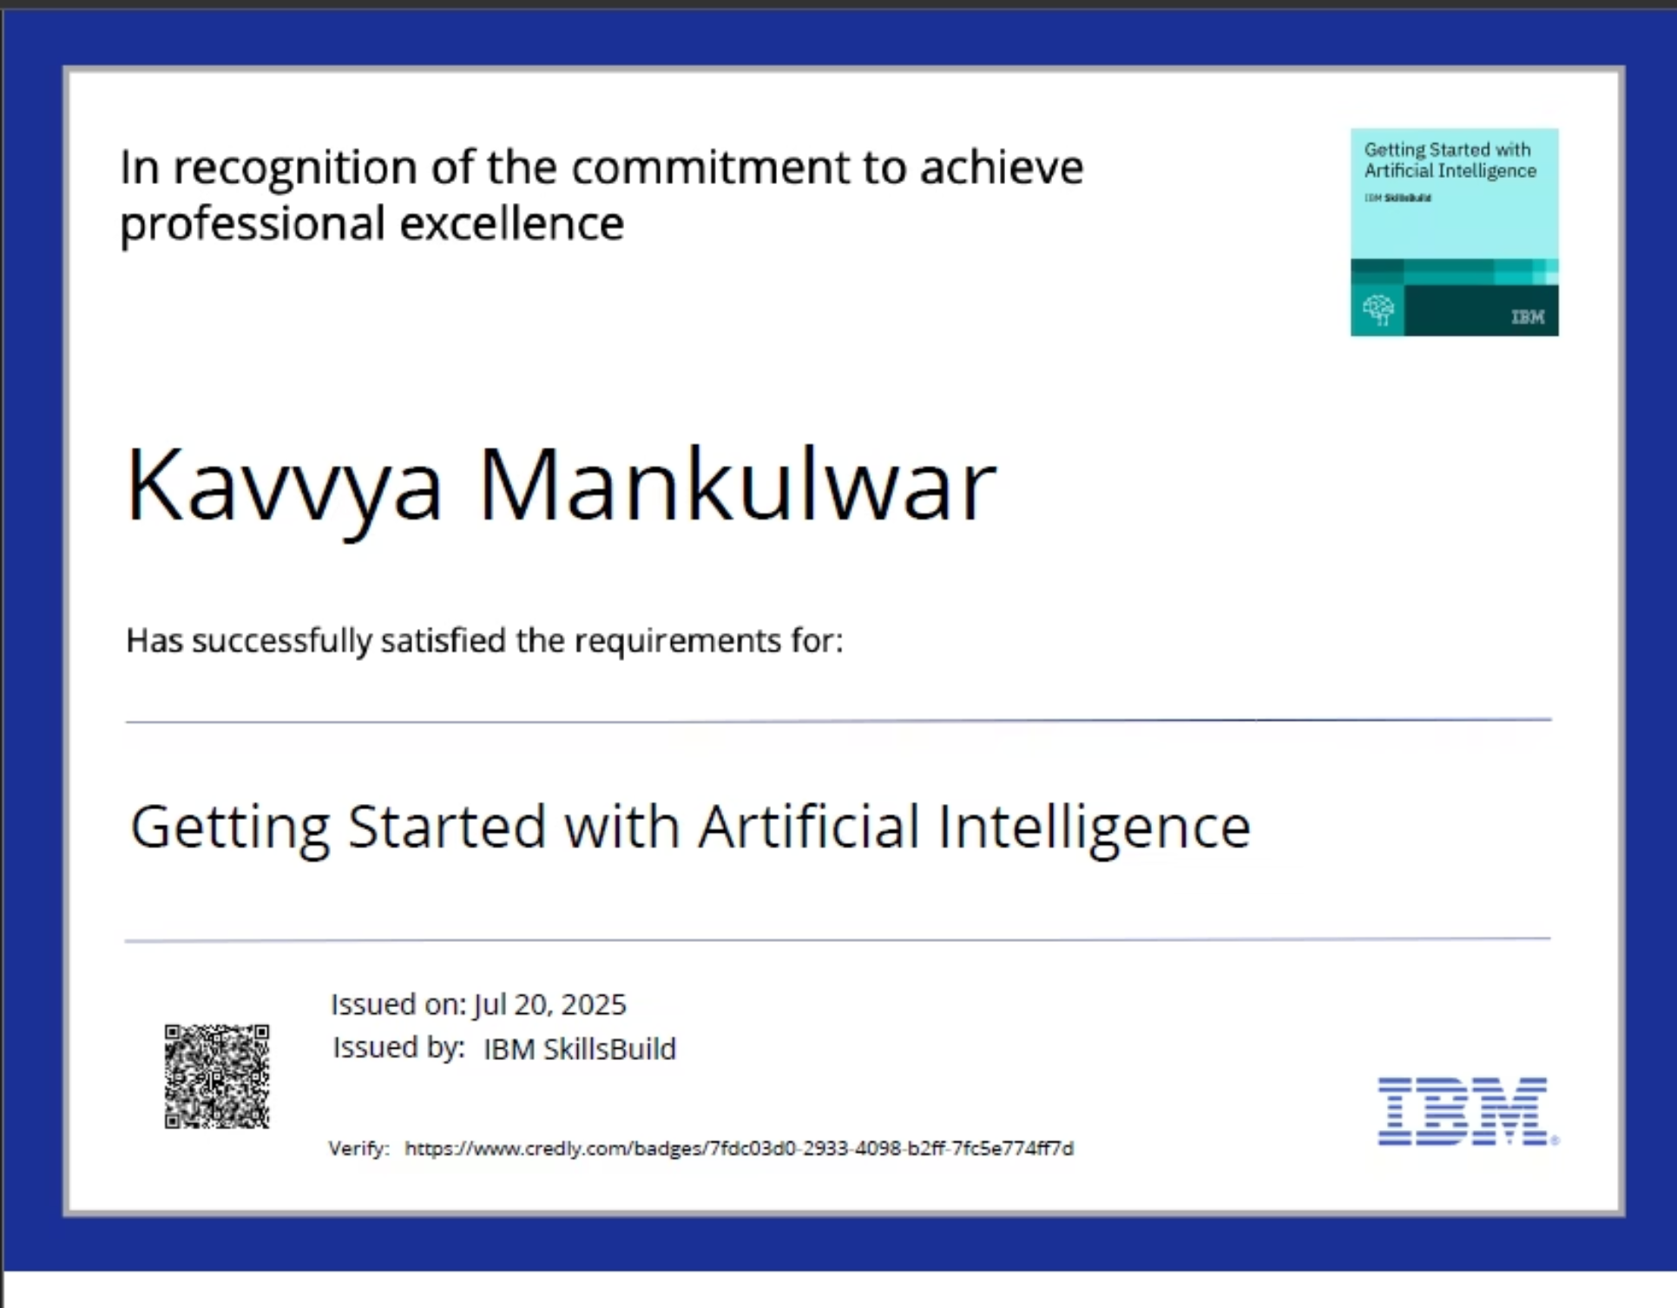
IBM CERTIFICATIONS
Getting Started with Artificial Intelligence

Slide 21
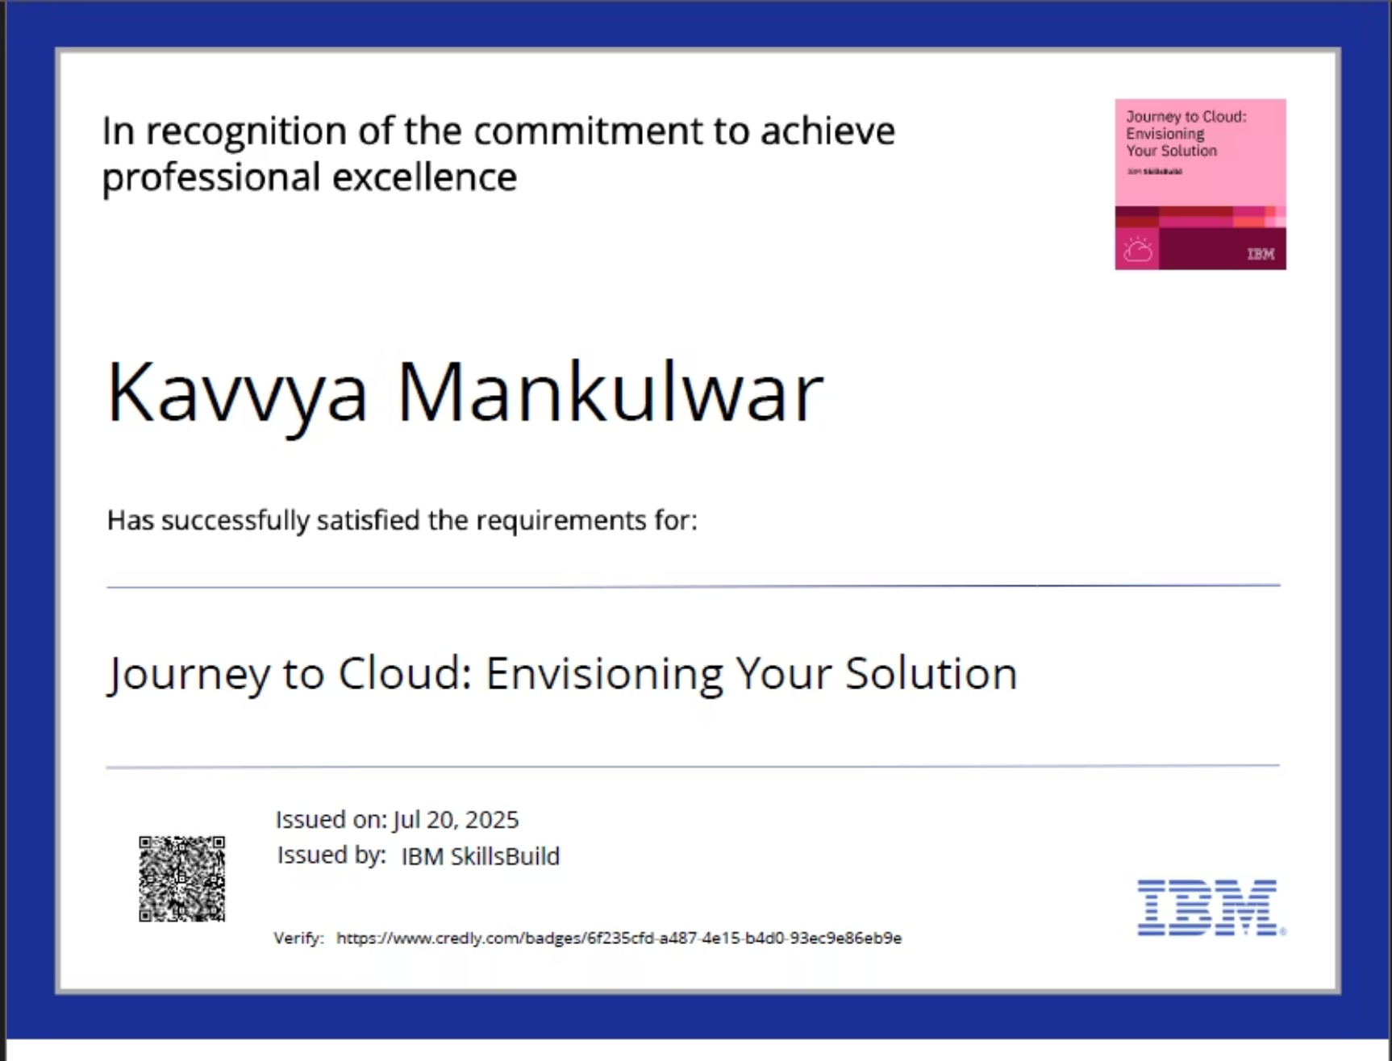
IBM CERTIFICATIONS
Journey to Cloud: Envisioning Your Solution

Slide 22
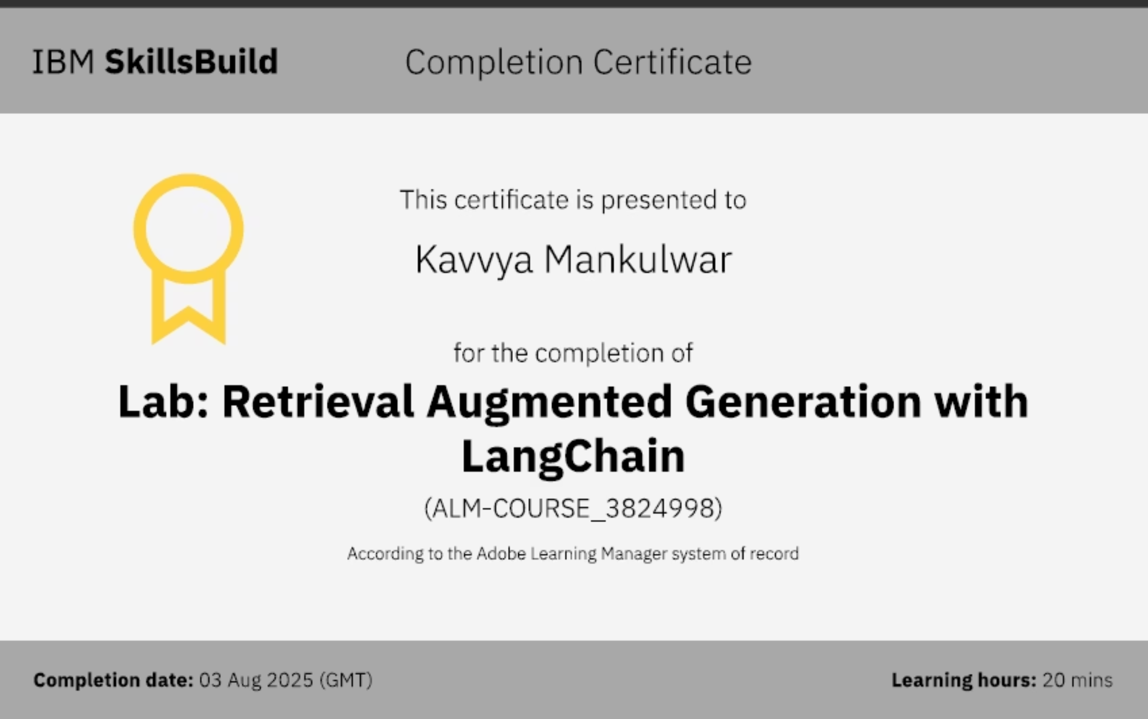
IBM CERTIFICATIONS
RAG LAB

